Slide 1
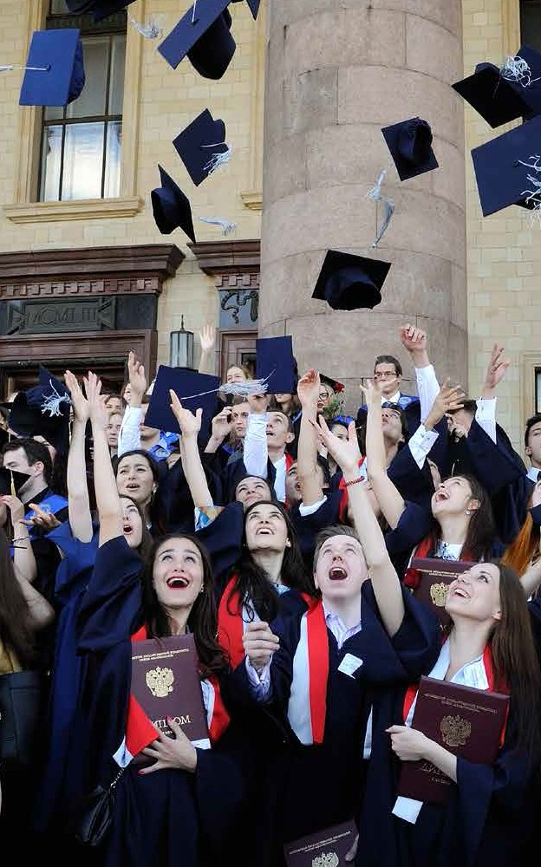



of the
M.V. Lomonosov Moscow State University
THE MOSCOW SCHOOL OF ECONOMICS

Slide 2
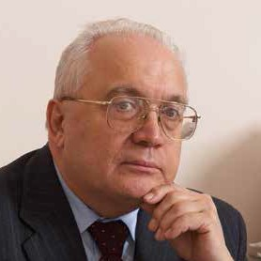
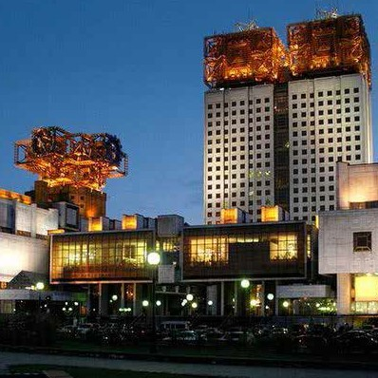
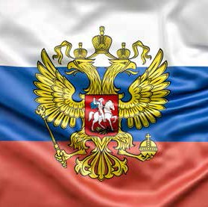
The foundation of the MSE MSU was actively supported by:
M.V.Lomonosov Moscow State University Rector, Full Member
of the Russian Academy of Sciences VIKTOR A. SADOVNICHY:
«Our plan is to make this school leading one not only in Russia but worldwide».
Scientific and Research Institutes
of the Russian Academy of Sciences:
Institute of Economics
Central Economics and Mathematics Institute
Institute for Economic Forecasting
Institute for Socio-Economic Studies of population and others
Major governmental Institutions Among them:
The Central Bank of Russia
Moscow Interbank Currency Exchange (MICEX)
Federal Financial Markets Service of Russia (FFMS)

Slide 3
MSE MSU History
Reasons for Founding MSE MSU:
Changing in international standards of modern economists training;
Active development of economic science in Russia and worldwide;
Increasing complexity of economic processes and methods of economic information processing;
The need for integrating economic science and education;
Vast professional experience accumulated by scholars of RAS and other scientific institutions in researching current economic processes of theoretical and practical significance;
Growing demand shown by business and government bodies for economists equipped with knowledge of modern economic realities.

Slide 4
The main stages of development
• 2004
April: The order on founding Moscow School of Economics was signed July: First students joined MSE Master’s Program in Economics
• 2005
First students joined MSE Bachelor’s Program in Economics
• 2006
The first group of Master’s Program graduates in Economic Theory and Problems of Modern Russia
From 2004 to 2007 the following Departments were set up:
Department of General Economic Theory chaired Full Member of RAS Alexander D. Nekipelov Department of Econometrics and Mathematical Methods in Economics. Associate Professor, PhD in Physics and Mathematics Aleksey N. Kurbatsky has been temporarily acting as the Head of the Chair Department of Economic and Financial Strategy chaired by Professor Vladimir L. Kvint
Department of Social Disciplines and Humanities chaired by Professor Viktor B.Kuvaldin

Slide 5
The main stages of development
• 2007
The Memorandum of Intentions with the Middle Tennessee State University (USA) was signed The Memorandum of Intentions with the Lassalle University (Pennsylvania, USA) was signed The second group of Master’s Program graduates
• 2008
First graduates of professional retraining course in Economic Theory and Practice of Economic Systems Operation
The third Master’s Program graduates
The first enrollment of Master degree students for a new course of Financial Economics
• 2009
The fifth anniversary of MSE MSU
The Memorandum of Cooperation with the State University of New York, Stony Brook (SUNY) was signed The fourth group of Master’s Program graduates
The first group of Bachelor’s Program graduates

Slide 6
The main stages of development
• 2010
The fifth group of Master’s Program graduates (including first graduates in Financial Economics) The second group of Bachelor’s Program graduates
INTER RAO UES top managers graduating from the professional refreshing course in Financial Strategy and Economic Efficiency Assessment of Economic Systems
The Memorandum of Cooperation with Alma Mater Studiorum University of Bologna (Italian Republic) was signed The Memorandum of Cooperation with the Pavia University (Italian Republic) was signed
The Memorandum of Cooperation with the University of Rome “Tor Vergata” (Italian Republic) was signed The Memorandum of Cooperation with the Frankfurt School of Finance and Management (Germany) was signed
• 2011
The sixth group of Master’s Program graduates (for the first time, students who have completed their full 6-year long course of studies, beginning with the first year of Baccalaureate, receive their Master Diplomas)
The third group of Bachelor’s Program graduates
MSE MSU gave start to its post-graduate course of studies in the following subjects: Economic Theory (08.00.01) and Mathematical and Instrumental Methods in Economics (08.00.13)
A new Master’s Program with concentration on Business-oriented economic theory and Fuel and energy economics.

Slide 7
The main stages of development
• 2012
The seventh group of Master’s Program graduates The fourth group of Bachelor’s Program graduates
The Memorandum of Cooperation with the Lassalle University (Pennsylvania, USA) was signed
A group of students from Frankfurt’s School of Finance and Management: took a course of lectures at the MSE MSU on the subject: «The State Economic Policy and Management» during March.
All the lectures were held in English.
The joint training course worked out by professors of the MSE MSU’s General Economic Theory Chair and their colleagues from Frankfurt School of Finance and Management is over.
INGOSSTRAKH top managers graduating from the professional refreshing course in Financial Strategy and Financial Management
• 2013
The eighth group of Master’s Program graduates The fifth group of Bachelor’s Program graduates
MSE MSU gave start to its new post-graduate course of studies on the subject: Economics and national economy management (08.00.05)

Slide 8
The main stages of development
• 2014
The ninth group of Master’s Program graduates The sixth group of Bachelor’s Program graduates The tenth anniversary of MSE MSU
The Agreement of Cooperation with the Primorska University (Koper, Slovenia) was signed
• 2015
The tenth group of Master’s Program graduates
The seventh group of Bachelor’s Program graduates The eleven anniversary of MSE MSU
• 2016
The eleventh group of Master’s Program graduates The eighth group of Bachelor’s Program graduates The twelve anniversary of MSE MSU

Slide 9
The main stages of development
• 2017
The twelfth group of Master’s Program graduates The ninth group of Bachelor’s Program graduates The thirteenth anniversary of MSE MSU
The Memorandum of Cooperation with the Leicester University (UK) was signed MSE MSU gave start to two new international masters programmers in English:
Economics and Finance (double degree with University of Primorska, Koper, Slovenia) Global Economics and Finance
Approved a joint programme of the MSE MSU and the Department of Mechanics and Mathematics (MSU): "Mathematics and Economics"

Slide 10
The main stages of development
• 2018
The thirteenth group of Master’s Program graduates The tenth group of Bachelor’s Program graduates The fourteenth anniversary of MSE MSU
• 2019
The fourteenth group of Master’s Program graduates The eleventh group of Bachelor’s Program graduates The fifeenth anniversary of MSE MSU
The first group of English-language Master’s Program graduates
• 2020
The fifteenth group of Master’s Program graduates The twelve group of Bachelor’s Program graduates The sixteenth anniversary of MSE MSU
The new Master’s programme «Open Economy in the Modern World» was approved
In the period from 2004 till 2020 a total number of MSE MSU’s graduates was 1307,
among them: Bachelor’s Program graduates - 806 and Master’s Program graduates - 501.

Slide 11
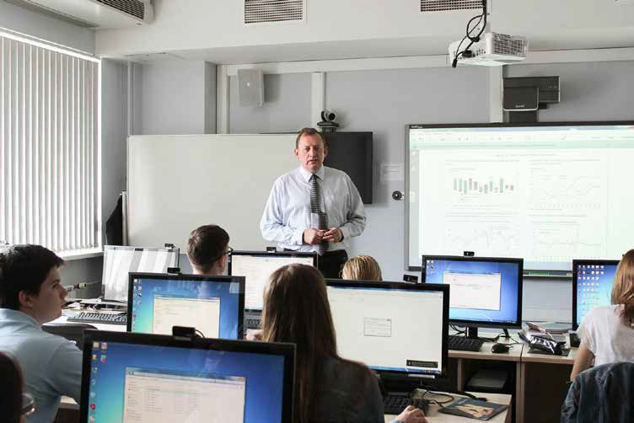
Students
Bachelor courses: 287
Master courses: 120 International English Language Master Degree Program: 58 PHD courses: 8
Lecturers
Total: 72
Full members of the RAS: 2 Foreign members of the RAS: 1
Corresponding Members of the RAS: 2 Doctors of Sciences and Professors: 25 Foreign professors: 7
MSE MSU Today

Slide 12
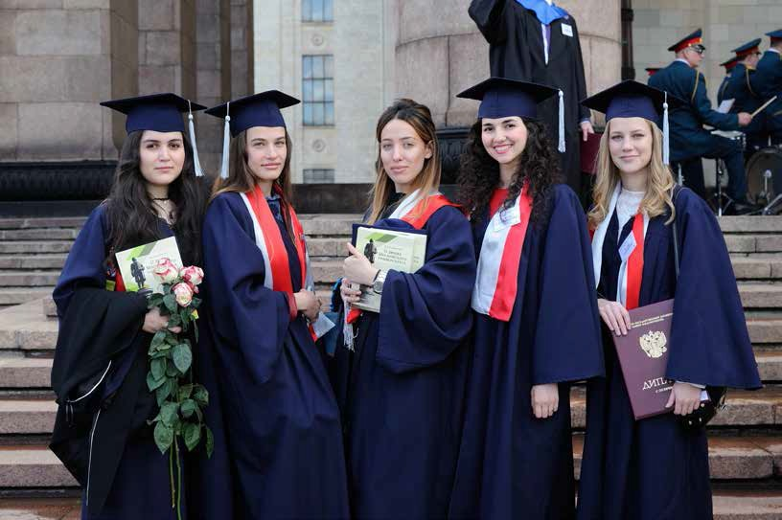
Educational schedule for bachelor course
Total – 3973 hours in class including
1686 lectures
2287 workshops & tutorials
53 courses including:
9 common humanitarian and social-economic courses
10 common mathematic
12 common economic subjects
19 professional subjects

Slide 13
Educational schedule for Master’s courses
Open Economy in the Modern World
Total – 1184 hours in class including:
236 lectures
948 workshops & tu
26 courses including:
5 common economic subjects
21 professional subjects
Economic and financial strategy
Total – 1168 hours in class including:
250 lectures
918 workshops & tutorials
30 courses including:
4 common economic subjects
26 professional subjects
Economics and mathematical methods
Total – 1288 hours in class including:
270 lectures
1018 workshops & tutorials
32 courses including:
4 common economic subjects
28 professional subjects

Slide 14
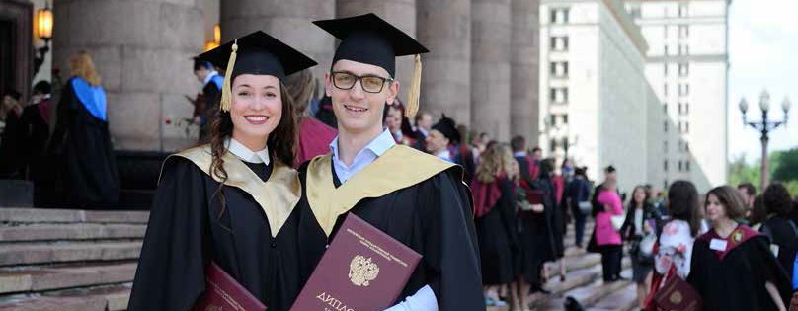
Educational schedule for Master’s courses
Global Economics and Finance
Working language of the program: English
International Master programme in Economics and Finance
Joint Masher’s programme in cooperation with Faculty of Management, Primorska University, Slovenia.
Working language of the program: English

Slide 15
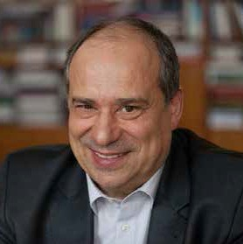
Our Leading Faculty
Alexander D. Nekipelov
Director of the MSE MSU Full Member of RAS
Graduated in 1973 from the Economic Faculty of M.V. Lomonosov MSU. Expert in comparative studies and the theory of economic systems’ operation and management, author and co-author of more than 200 scientific publications,
including two monographs.
Member of the scientific council under the RF Security Council and of the Scientific Expert Council. In mid-1990s Alexander D. Nekipelov was among the founders of the Russian-American Group for Economic Transformation, which played an important role in criticizing the Washington Consensus-based economic policy and elaborating
an alternative approach to systematic transformation

Slide 16
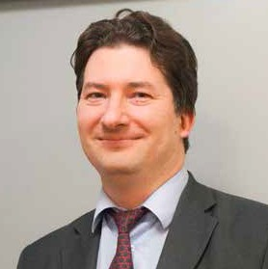
Our Leading Faculty
Mikhail Y. Golovnin
Professor of the MSE MSU General Economic Theory Chair The First deputy Director of the Institute of Economics, RAS.
Corresponding Member of RAS
Doctor (Economics).
He holds a course of lectures on "The global economics"
and "Economic policy".

Slide 17
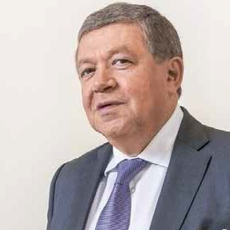
Our Leading Faculty
Ruslan S. Grinberg
Scientific Director Institute of Economics, RAS,
Corresponding Member of RAS, Doctor (Economics), Professor.
He holds an original special course of lectures on Economic Models
in Foreign Countries of the World.

Slide 18
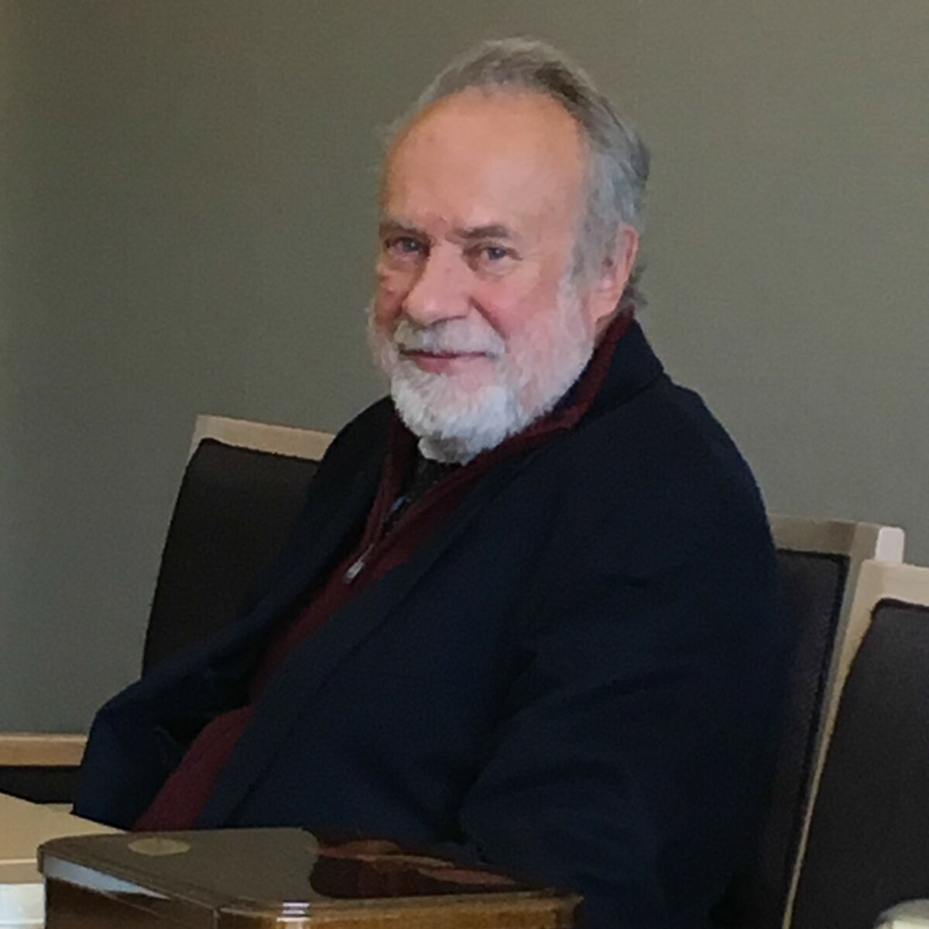
Our Leading Faculty
Yuri M. Kabanov
Professor, Doctor of Sciences in Physics and Mathematics. Professor of mathematics, Besançon University (France).
Holds a lecture course on Financial Mathematics.

Slide 19
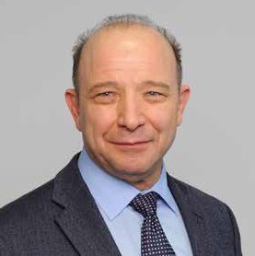
Our Leading Faculty
Vladimir L. Kvint
Head of MSE Department of Economic and Financial Strategy,
Foreign Member of RAS, Doctor (Economics), Professor,
Honored Worker of Higher School of the Russian Federation. Laureate of the Lomonosov Moscow state University Prize
for scientific works of I degree.
He holds a course of lectures on Strategy Theory and Strategizing Methodology.

Slide 20
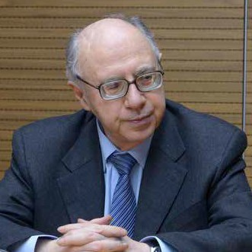
Our Leading Faculty
Georgii B. Kleiner
Deputy Scientific Director, Central Economics and Mathematics Institute RAS,
Corresponding Member of RAS, Doctor (Economics), Professor.
He holds a course of lectures on Firm Theory
and Strategic Planning.

Slide 21
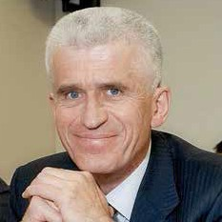
Our Leading Faculty
Viktor B. Kuvaldin
Head of MSE Department of Social Disciplines and Humanities,
Doctor (History), Professor.
He reads two courses of lectures entitled The Making of the Global World: Political and Economic History 20th Century, The Global World: Economy and Politics.

Slide 22
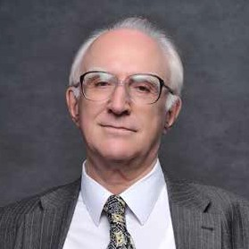
Our Leading Faculty
Viktor M. Polterovich
MSE MSU Deputy Director for Masters, PhD and Post-graduate Programs,
Head of the Mathematic and Economic Laboratory, Central Economics and Mathematics Institute RAS,
Full Member of RAS, Doctor (Economics), Professor.
Member of the UN Committee for Development Policy (CDP UN).
He holds two courses of lectures on Modern Mathematical Instruments for Economic Analysis,
and on Theory of Economic Reforms

Slide 23
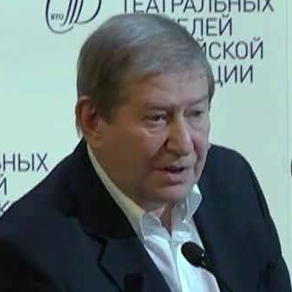
Our Leading Faculty
Alexander J. Rubinshtejn
Head of the Scientific Division for the Theoretical Economics,
Institute of Economics (IE) RAS. Head of the Chair of Economy and Management, V.I. Nemirovich - Danchenko
Theater School (Higher Educational Institution) attached to A. P. Chekhov Moscow Art Theatre, Candidate (Economics), Doctor (Philosophy), Professor.
He holds a course of lectures on Economic Sociodynamics.

Slide 24
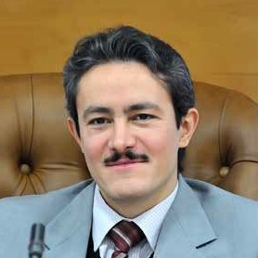
Our Leading Faculty
Dean Fantazzini
Professor of the Department of Econometrics and Mathematical Methods in Economics of MSE MSU,
Deputy Head of this Department.
Ph.D. in Economics.
He was research fellow at the Chair for Economics and Econometrics, University of Konstanz (Germany) and at the Department of Statistics and Applied Economics, University of Pavia (Italy). Specialist in the time series analysis,
financial econometrics, multivariate dependence in finance and economics.
He holds a course of lectures (in English) on Modern Methods of Time Series Analysis.

Slide 25
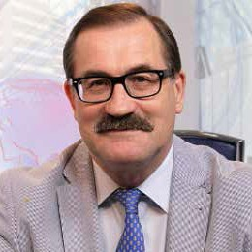
Our Leading Faculty
Yuri A. Scherbanin
Head of Laboratory, Institute of Economic Forecasting RAS,
Doctor (Economics), Professor.
He holds a course of lectures on World Economy.

Slide 26
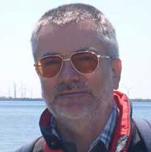
Foreign professors
Andrei V. Bazhanov
Queen’s University, Department of Economics (Kingston, ON, Canada) Visit-Professor of the MSE MSU General Economic Theory Chair.
Holds a course of lectures Series «Economics of Natural Resources»

Slide 27
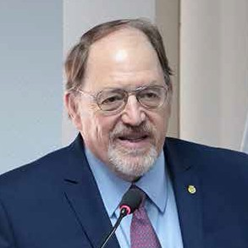
Foreign professors
James K. Galbraith
Professor of Government at the Lyndon B. Johnson School of Public Affairs and at the Department of Government,
University of Texas at Austin.
He is also a Senior Scholar of the Levy Economics Institute and chairman of «Economists Supporting Arms Reduction» (ECAAR).
He writes a column on economic and political issues for the «Texas Observer».

Slide 28
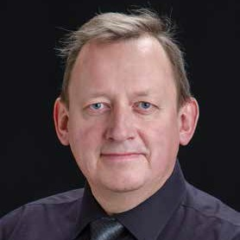
Foreign professors
Alexey P. Kireyev
Doctor in Economics, Professor.
Lead international economist, International Monetary Fund.
He holds a course of lectures on Applied International Macroeconomics.

Slide 29
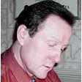
Foreign professors
Alexander V. Melnikov
Professor of Mathematics and Statistical Sciences,
University of Alberta (Canada). In 2009 he was awarded the prestigious McCalla Professorship of the University.
He specializes in mathematical finance, risk management, insurance and statistics. Author of five books and more than 100 scientific publications. Academician of the Russian Academy of Natural Sciences (RAEN), editor-in-chief of the journal “Risk Management”.
He holds a course of lectures on Financial Mathematics in Strategizing Processes.

Slide 30
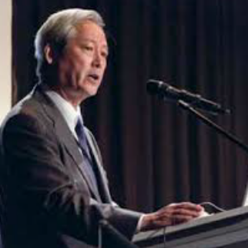
Foreign professors
Daisuke Kotegawa
Research Director (The Canon Institute for Global Studies)
Senio-r Advisor, PWC Arata, Japan Former Executive Director for Japan, IMF
He holds a course of lectures on
«World economy from Japanese perspective with emphasis on Japan and China».

Slide 31
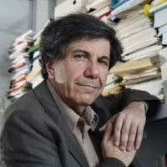
Foreign professors
Jacques Sapir
Foreign Member of RAS.
Professor in economics at L’École des Hautes Études en Sciences Sociales (EHESS) in Paris, and Director of Department
of the Post-Graduate Studies on Economic Development Comparative Research.
Director of the CEMI Research Center at EHESS. Consultant for the French Ministry of Foreign Affairs, and the Ministry of Defense.
Since 1999 scientific adviser to the TACIS - Ukrainian-European Policy and Legal Advice Centre (UEPLAC program) in Ukraine. He holds a course of lectures on Relevance, Importance and Strategies of Information Economics (in English).

Slide 32
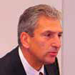
Foreign professors
Y. Joseph Ugras
Dean, College of Professional and Continuing Studies, La Salle University, USA.
He holds a course of lectures Strategic Management Accounting (in English).

Slide 33
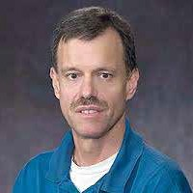
Foreign professors
Robert B.H. Hauswald
Associate Professor of Finance in Kogod School of Business, American University. Robert Hauswald received his PhD in Economics from Stanford University.
Before joining Kogod, he was an Assistant Professor of Finance at Kelley School of Business, Indiana University,
and at Smith School of Business, University of Maryland,
Frankfurt University (Germany).
R. Hauswald has been a visiting scholar at the Federal Deposit Insurance Company, extensively consults for the World Bank, and currently holds an appointment as research fellow at the Center for Financial Studies. Prof. Hauswald has worked for Citibank and Deutsche Bank AG and as an independent consultant.
He holds a course of lectures (in English) on Strategic Project Financing.

Slide 34
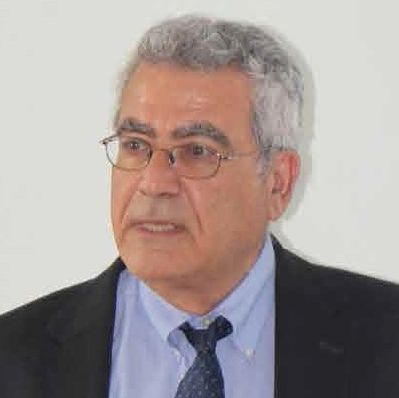
Foreign professors
Yochanan Shachmurove
Professor of the City College of New York University (Department: Economics) Visit-Professor of the MSE MSU General Economic Theory Chair.
Holds a course of lectures Series
«Advanced International Economics» (In English)

Slide 35
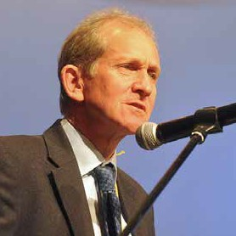
Foreign professors
Jan Aart Scholte
Professor Global Transformations and Governance Challenges, Faculty Governance and Global Affairs, Institute of Security and Global Affairs,
Leiden University (The Hague The Netherlands).
He worked at the University of Warwick, (UK). Previous positions: at the University of Sussex, University of Gothenburg, (Sweden) and the Institute
of Social Studies. He has advised a number of national and local governments as well as global agencies such as the International Monetary Fund, the world Trade Organization, and the Internet Corporation for Assigned Names and Numbers.
Holds a course of lectures (in English) «Strategic Management of the Global Market Space and the World Economy».

Slide 36
Students practice
MSE’s instruction plans envisage an academic-pedagogical and pre-graduation practice, practical lessons and research work
in the following profile RAS institutes: Institute of Economics
Central Economics and Mathematics Institute Institute of Economic Forecasting
Institute of Social and Economic Studies of Population Institute of World Economy and International Relations
as well as in the biggest financial and industrial corporations and banks.

Slide 37
Our Graduates
MSE MSU graduates get fundamental mathematical training, deep insight into Russia’s economic realities and specifics, gain a professional understanding of all major sections and modern trends of economics, which grant them additional competitive advantages for employment in federal and regional governing bodies, corporations, research institutions and higher schools. MSE MSU graduates have good chances
to start working in planning, economic, information and analytical organizations, in asset management, project financing, risk assessing departments, etc. Substantial theoretical training, vast practical experience, communication with leading Russian and foreign professors ensure that MSE
students become broad-minded professionals with a non-trivial way of thinking, capable
of finding daring and original solutions. Today MSE MSU graduates are successful employees in the RF Presidential Administration, federal and regional governmental bodies,
big commercial organizations, in economic research institutes of RAS.

Slide 38
Our Graduates
For example, Kirill Zorin is on the staff of the RF Presidential Administration, Alexander Karavaitsev – working in the International grains
Council (London), Andrey Skubko - financial analyst at PPF Real Estate Russia, Sergey Agibalov is senior expert, Department of Economics, Institute of Energy and Finance. Darya Panchuk is leading expert in the Department for Economics and Business Planning, Rosneft Public JSC.

Slide 39
Our Graduates
Our graduates, after completing their post-graduates studies at the Institute of Economics RAS, defended their Candidate Theses: in April 2009 Kirill Zorin (2006 Master’s Program graduate), in October 2010 Darya Panchuk (2009 Master’s Program graduate), in December 2010 Tatyana Podolyako (2006 Master’s Program graduate), in June 2013 Andrey Beletskiy (2011 Master’s Program graduate), in July 2016 Violetta Arkhipove (2012 Master’s Program graduate). 2010 Master’s Program graduate Alexander Zaitsev completed his
post-graduate studies at the Institute of Economics RAS, now he holds seminars with MSE MSU Master’s Program students. Since 2011 MSE MSU has its own post-graduate courses. In June 2015 Marina Leschaikina (graduate from MSE MSU post graduate courses) defended her thesis at the Central Economics
and Mathematics Institute RAS; in September 2016 Irina Bogatova (2009 Bachelor’s Program, 2011 Master’s Program and MSE MSU Post-graduate courses graduate) defended her thesis
at the Institute of Economics RAS. Anna Hvorostyanaya and Nikita Sasaev also successfully defended their candidate thesis recently. Former MSE MSU students neither lose contacts with each other, nor with their Alma Mater. They are always welcome at the Diploma delivery ceremony, Faculty
Day festivities, International Conferences and round table discussion held by MSU MSE.

Slide 40
Our Guests
The opportunity to communicate with well-known politicians and researchers, personalities of literature and arts, representatives of various regions helps MSE students be better conversant with problems of the modern world and acquire a broader world outlook.
Over the years of MSE existence its guests were: USSR President Mikhail Gorbachev, US President George Bush, Sr., US Under Secretary of State for Economic, Energy, and Agricultural Affairs Robert D. Hormats; the 2006 Nobel Prize Winner in Economics, Professor of the Columbia University Edmund Phelps; Director of the A.S. Pushkin State Museum of Fine Arts, Academician of Russian Academy of Arts, Irina Antonova; Rector of the Middle Tennessee State University, Dr. Sidney A. McFhee; representatives of UN Food and Agriculture Organization (FAO) Headquarters; Rector of the University Carlos III in Madrid Prof. Daniel Pena Sanchez de Rivera; Head of CEOs’ International organization Sir Freser Morrison; Russian ice hockey player, champion of the USSR, World and Olympic Games, Senator Vyacheslav A. Fetisov, former Vice President of RF Chamber of Commerce and Industry Alexander M. Rybakov; popular film actor Hugh Grant, gorier Foreign Minister of the Italian Republic, former Vice-President of the European Commission Franco Frattini as well as other renowned public figures, scientists and politicians.

Slide 41
Admission conditions and forms of study at MSE MSU
The study in MSE MSU is paid
(Payments for accommodation and healthcare services are not included in tuition cost)
The best students may count with grants from sponsors
MSE MSU has paid Preparatory Courses (for secondary school children and Bachelors)
The aim of the Courses is to prepare the students to access MSE MSU Bachelor’s and Master’s

Slide 42

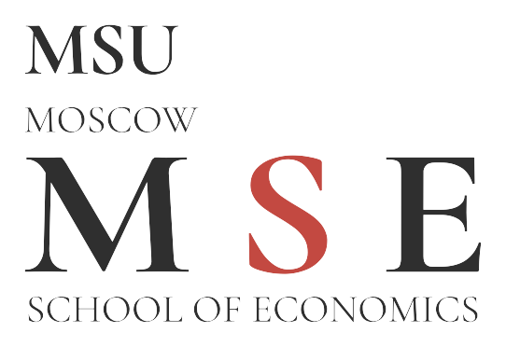
Our contacts
1, Building 61, Leninskie Gory, M.V. Lomonosov MSU, Moscow, Russia, 119234 Phone: +7 (495) 510 52 67, 510 52 68. Fax: +7 (495) 510 52 69
E-mail: mail@mse-msu.ru
www.mse.msu.ru

