Slide 1
More inequalities: the longterm social consequences of the ongoing epidemic in the neoliberal economic environment"
Reflecting on the current crisis

Slide 2
What are social consequences?
The concept of social consequences points to changes that occur as a result and in the wake of major events in environment, economy, society or international relations.
The social consequences are usually enhancement, weakening or annulment of the already existing tendences.
The most salient tendency of the last three decades in the social world is relentless march of inequality resulting from the implementation of the “cynical” neoliberal view of society.
The rising inequality owes to the commercialization and marketization of essential services rendered by the state and privatization of public goods.
The major question is: how will the present crisis affect the inequalities that have so far emerged in modern and not-so-modern socities?

Slide 3
Perception of conflict potential in the Russian society

Slide 4
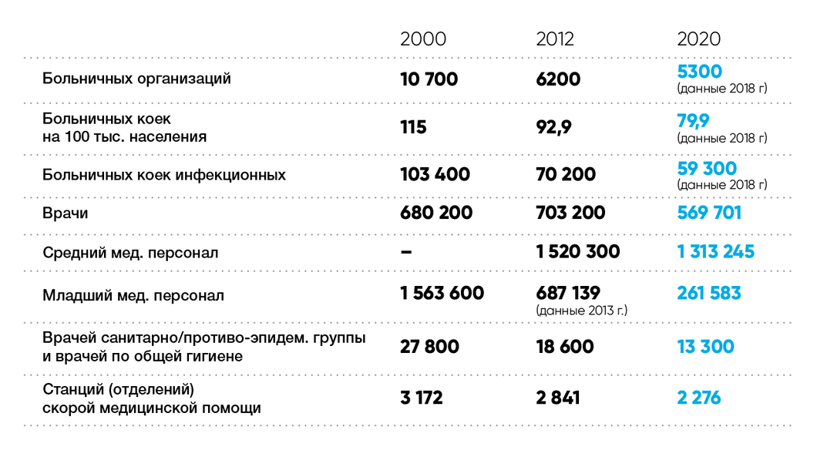
The outcome of the medical reforms
Clinics, medical organizations
Beds in clinics per 100 th.
Beds for infection treatment
Medical doctors
Skilled medical assistants
Low skill medical personnel
Prophylactics and hygiene doctors
Emergency ambulances

Slide 5
Health care inequality: optimization and privatization of health care services

Slide 6
Problems with getting assistance
 | INCOME GROUP
 | We can hardly make ends meet | Buying clothes is a problem | Durables are a problem | Real expensive things are a problem | Real estate is a problem | No limitations
Never | 5,7% | 2,6% | 1,1% | 1,0% | 1,7% | 0,0%
In most cases we don't | 17,9% | 9,5% | 5,9% | 4,9% | 5,0% | 5,7%
In half cases we do, in half we don't | 28,3% | 23,0% | 19,2% | 17,8% | 15,7% | 5,7%
In most cases we don't | 14,2% | 21,9% | 23,9% | 25,2% | 26,7% | 25,7%
Always do | 27,4% | 34,3% | 43,2% | 45,8% | 47,1% | 51,4%
No need | 6,6% | 8,7% | 6,6% | 5,3% | 3,9% | 11,4%

Slide 7
Precarity and self-employment
The rise of Individual entrepreneur – 6 mln. Mostly service sector.
Individual self-employment – 15 million: small-scale construction, caring for the elderly, cleaning and other services.
Individual landplot production - 18720,8 in 2016. (Narodonaselenie, №4, 2019, P.92)
The “horizontal” economy is bound to grow in response to the shortage of assistance from the state. Hernando deSoto: “illiegal economy is a chaotic and creative reaction to the inability of the state to respond to the needs of the impoverished strata”.

Slide 8
The poor are victimized by the reforms.
 | В81. ГРУППА ДОХОДА
 | We can hardly make ends meet | Buying clothes is a problem | Durables are a problem | Real expensive things are a problem | Real estate is a problem | No material limitations
 | Среднее | Среднее | Среднее | Среднее | Среднее | Среднее
Medical services are too expensive | 3,78 | 4,15 | 3,86 | 3,54 | 3,40 | 2,46
Staying at a hospital costs too much | 3,23 | 3,67 | 3,44 | 3,06 | 3,12 | 2,42
There are no specialists of the necessary profile | 3,32 | 3,50 | 3,42 | 3,11 | 3,15 | 3,25
Clinics are too far from the place where I live | 2,39 | 2,41 | 2,51 | 2,26 | 2,36 | 1,62
No necessary equipment | 3,23 | 3,35 | 3,21 | 2,86 | 2,93 | 2,42
Hard to get a readdress for medical examination | 3,37 | 3,19 | 3,14 | 2,86 | 2,76 | 2,31
No medical insurance | 2,03 | 1,87 | 1,80 | 1,58 | 1,66 | 1,83
Doctors are of low skills | 3,34 | 3,36 | 3,28 | 2,89 | 3,04 | 3,00
Limited to the region use of insurance | 2,66 | 2,71 | 2,61 | 2,39 | 2,41 | 2,50

Slide 9
What it means for the future?
The debate over the well-fare state is bound to get a heated continuation.
Health care is bound to get more money.
Doctors will ensure their place in the middle class. The occupational solidarity will become stronger.
Medical schools will get stronger state support

Slide 10
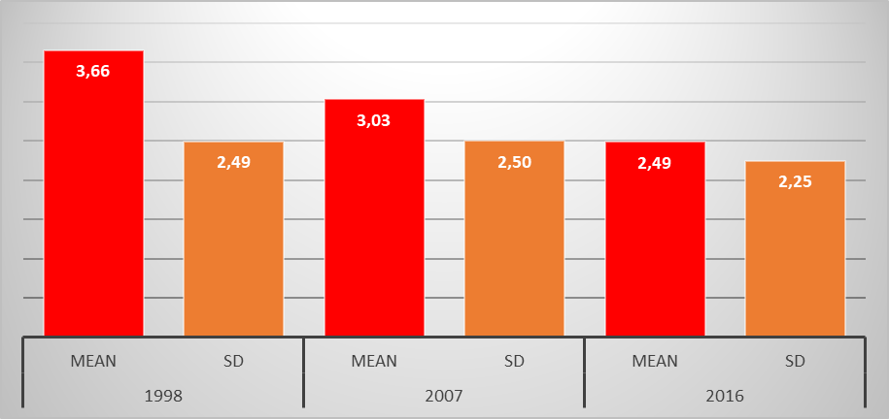
Middle class autonomy tendencies
The index of autonomy was created on the basis of 6 questions designating one autonomy dimension. It ranges from 0 to 10. At present the autonomy level mean is equal to 2.5. It has been streadily declining since 1998.

Slide 11
The decline of the middle class decision-making power
Decision-making in the middle class is redistributed in favor of the stratum with more authority and more connections with the government.

Slide 12
Inter-ethnic tension on the rise: factors of inter-ethnic intolerance
 | B | Sq.err. | Wald | DF | Sig | Exp (B)
Sex | -,244 | ,106 | 5,328 | 1 | ,021 | ,783
Age | ,240 | ,043 | 31,122 | 1 | ,000 | 1,271
Type of settlement | ,391 | ,045 | 75,967 | 1 | ,000 | 1,478
Economic status on a 9 point scale | ,097 | ,053 | 3,301 | 1 | ,069 | 1,102
Political influence on a 9-point scale | ,065 | ,044 | 2,191 | 1 | ,139 | 1,068
Respect on a 9-point scale | ,003 | ,038 | ,006 | 1 | ,941 | 1,003
Satisfaction with life in general | -,234 | ,057 | 17,119 | 1 | ,000 | ,791
Change of economic well-being | -,438 | ,066 | 43,528 | 1 | ,000 | ,646
Loss of job anxiety | ,000 | ,000 | 2,135 | 1 | ,144 | 1,000
Ethnic identity strength | -,249 | ,088 | 7,986 | 1 | ,005 | ,780
Constant | -,587 | ,434 | 1,832 | 1 | ,176 | ,556

Slide 13
Causes of inter-ethnic tensions:the role of employment ( Binary regression results)
 | B | St.error | Wald | DF | Sig | Exp(B)
Age | ,045 | ,033 | 1,803 | 1 | ,179 | 1,046
Well-being | -,016 | ,075 | ,049 | 1 | ,826 | ,984
Settlement type | -,157 | ,034 | 21,262 | 1 | ,000 | ,855
Type of contract: official vs.unofficial | -,354 | ,141 | 6,286 | 1 | ,012 | ,702
Constant | 2,745 | ,265 | 107,480 | 1 | ,000 | 15,568

Slide 14
What is to be done?
The social and public goods have to be accepted as the necessary condition of cohesion in the world fraught with new dangers and challenges.
The change that has been hitting societies had has to come under review. A more balanced policies need to be worked out.
Societies should be reassembled on the basis of a new consensus, new factors of cohesion that can balance the existing dangers.
The global and the local should get their measure. It is obvious that all three levels of government - global, national state and local – should be brought into harmony.

